Slide 1
Dashboard Automation
LAM Research
26 Jun 2024 | SG OE Sharing

Slide 2

LAM Dashboard Automation Process Map - Before
Problem:
LAM Research admins were pulling out data manually from SAP for reporting purposes. This process was time consuming and limited operational managers' visibility into real-time warehouse space utilization and the inbound & outbound status. Consequently, posed a risk of failing KPIs and led to inefficiencies.
Start
SAP
Pull Reports from SAP
Manual Data Cleaning & Analytics
End
LAM Team

Slide 3

LAM Dashboard Automation Process Map - After
Start
SAP
Pull 14 Reports from SAP
Attach reports and send via email to Schenker PC
LAM PC
Receive email and save the reports on SharePoint.
Merge with Inbound & Outbound Master Files
Visualize in Power BI
End
Schenker PC
14 min
1 min
1 min
Refresh every 10 minutes
Time Saved

Slide 4
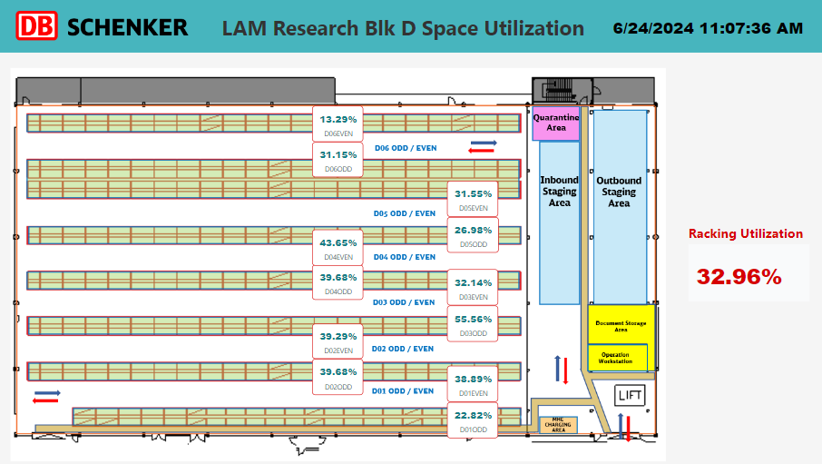

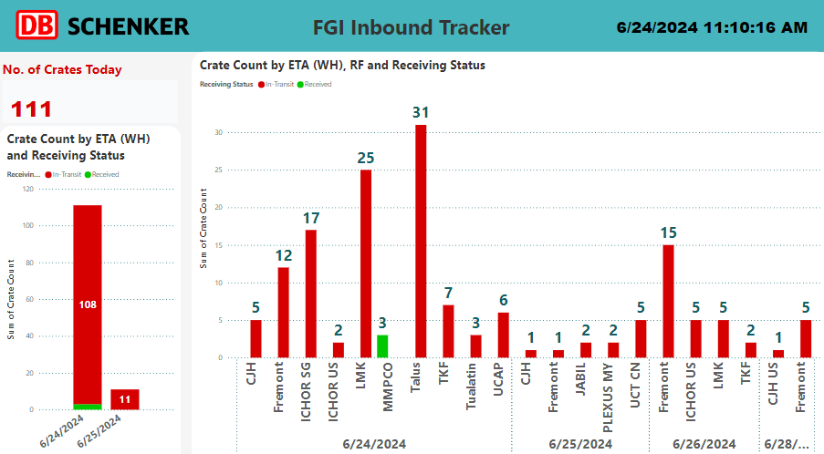

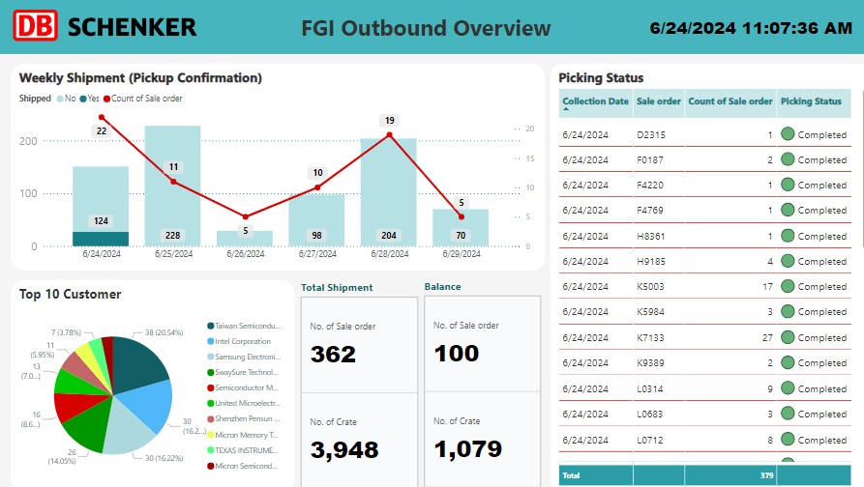

LAM Dashboard Automation Business Value
Operational Efficiency:
Proactive Planning
Optimized Space Management
Automated Data Reporting
Strategic Decision-Making:
Real-time Insights
Improved KPI Tracking
Customer Satisfaction:
Risk Mitigation
Customized Reporting
Notes:
-Risk Mitigation: Identifies inefficiencies and potential bottlenecks early, reducing operational risks.

Slide 5
Thank you

